Slide 1

Alfresco Security Best Practices
Toni de la Fuente
Alfresco Senior Solutions Engineer
Blog: blyx.com Twitter: ToniBlyx

Slide 2

Agenda
Intro
Project life cycle and security
  Planning
  Installation
  Post-install configuration and hardening
  Maintenance
  Monitoring and auditoring
Other security-related tasks
Conclusions
Next steps

Slide 3
Introduction

Slide 4
Introduction
In Alfresco we must take security seriously.
  Because we care about contents
If Alfresco stops working and that poses a problem for your business, security is important.
Security is a process not a product.
Think of protection, integrity and privacy.
Reduce as much as posible the MTBF, to guarantee minimum MTTR posible.
Taking into account the Security Plan of the organization, Contingency Plan and Disaster Recovery Plan.

Slide 5
Project Life Cycle and Security

Slide 6


















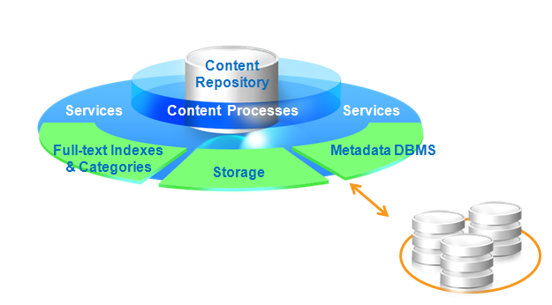
Planning and previous review
What should I secure? It depends on…
  Project needs
  Interfaces
  Users, applications or both
  Customization
  Architecture, high availability and scalability
Document
Management
Collaboration
Web Content
Management
Records
Management
Email
Archive
Interfaces?
Number of…?
Customization?

Slide 7

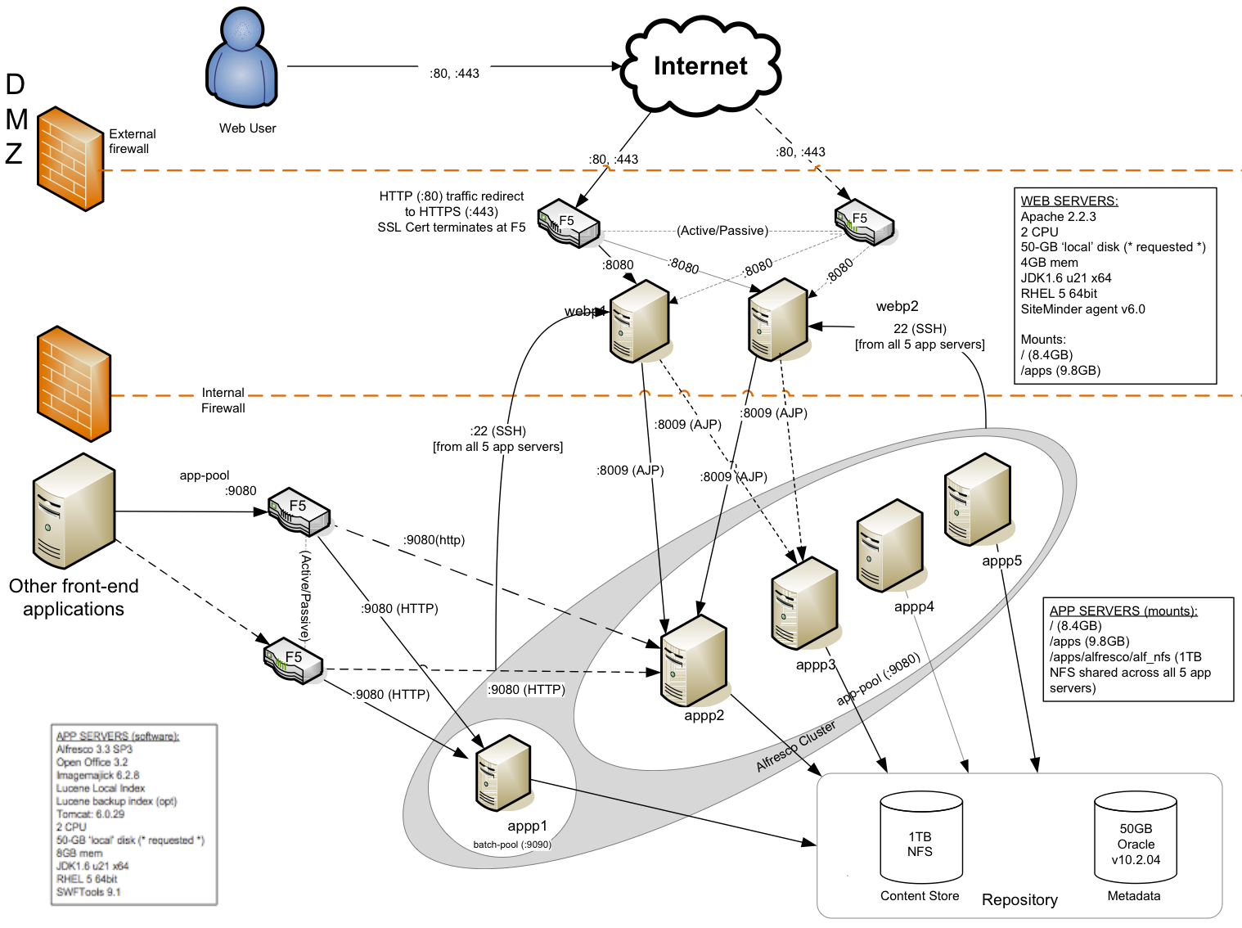

It depends on the network architecture
Share
Alfresco
App Srv
Content
Store
Index
DataBase

Slide 8
Installation

Slide 9
Best practices and tips 1/2
Run Alfresco as a non-root user
  Configure all ports beyond 1024
Avoid default password (admin, db, jmx).
Change default certificates and keys in SOLR.
  Use keytool or your own certificates.
  installRoot/alf_data/solr/CreateSSLKeystores.txt
Set permissions for configuration files, content store, indexes and logs. Only the user running Alfresco must be able to access this folders.
  chown –R alfresco:alfresco installRoot/
  chmod –R 600 installRoot/

Slide 10
Best practices and tips 2/2
Before installing run Alfresco Environment Validation Tool in order to avoid conflictive services and ports.
Keep SSL active when possible:
  Do not use self-signed certificates in live environments.
  Take care with SSL Strip: force using SSL and teach your users!
  Check your certificate strength on:
    https://www.ssllabs.com/ssldb/analyze.html
Use Apache (or other web server) to protect your application server and services.
SELinux (review alfresco.sh)
Authbind on Debian-like OS
When possible, run bundle installer to keep third party binary files controlled and avoid rootkits
  If third party applications are installed by OS rpm repository use rpm command
  rpm –Vf /path/to/binary
  rpm –V <rpm-name>
Check third party vulnerabilities often.

Slide 11
Post Installation Configuration

Slide 12
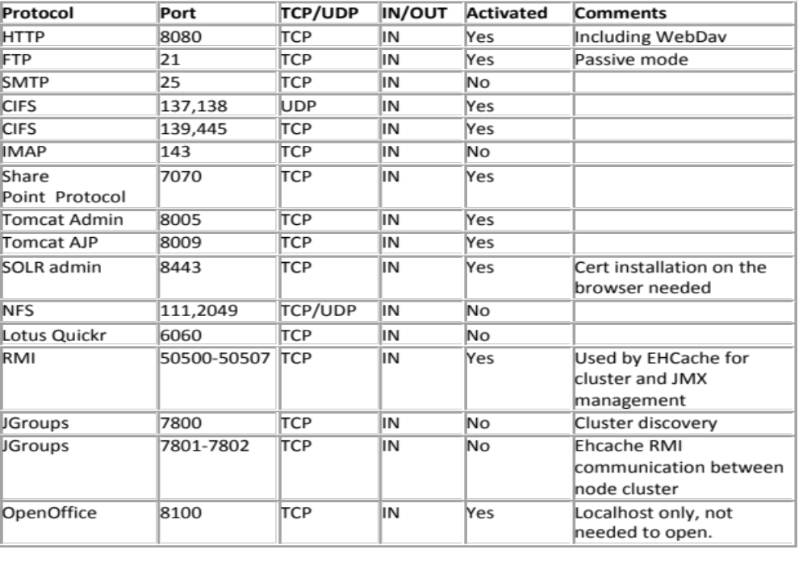
Which ports should I open? IN

Slide 13
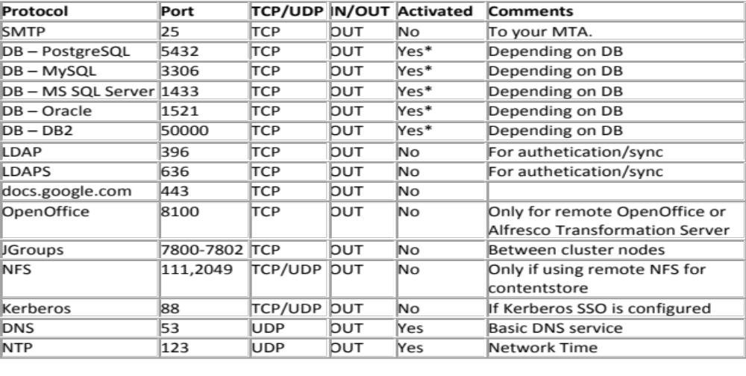
Which ports should I open and keep in mind? OUT
* Also allow outbound traffic to Facebook, Twitter, LinkedIn, Slideshare, Youtube, Flickr, Blogs if you are able to use Publishing Framework, Target Servers for Replication or Cloud Sync.

Slide 14
Control and review
Controls processes and ports used by the system (Linux):
# netstat -tulpn|grep -i java
tcp 0 0 0.0.0.0:50500 0.0.0.0:* LISTEN 8591/java
tcp 0 0 127.0.0.1:8005 0.0.0.0:* LISTEN 8591/java
tcp 0 0 0.0.0.0:8009 0.0.0.0:* LISTEN 8591/java
tcp 0 0 0.0.0.0:139 0.0.0.0:* LISTEN 8591/java
tcp 0 0 0.0.0.0:8080 0.0.0.0:* LISTEN 8591/java
tcp 0 0 0.0.0.0:21 0.0.0.0:* LISTEN 8591/java
tcp 0 0 0.0.0.0:8443 0.0.0.0:* LISTEN 8591/java
tcp 0 0 0.0.0.0:445 0.0.0.0:* LISTEN 8591/java
tcp 0 0 0.0.0.0:7070 0.0.0.0:* LISTEN 8591/java
udp 0 0 0.0.0.0:137 0.0.0.0:* 8591/java
On Windows OS:
  netstat –an | findstr <port #>
Notes:
On Windows OS: Netstat –an|findstr <port no>

Slide 15
Activate SSL for all services required
HTTP → HTTPS
  Appliance supporting SSL offloading
  Activate HTTPS on a frontal web server (Apache, IIS, etc)
  Activate HTTPS on the application server
FTP → FTPS
  Check official documentation
SharePoint (jetty) → SSL
  You will avoid MS users related workarounds
  Check official documentation
SMTP → SMTPS: IN and OUT
IMAP and JGroups (workarounds)

Slide 16
Post installation configuration - 1/5
Redirect ports below 1024:
  E.g. for FTP and IPTables:
    iptables -t nat -A PREROUTING -p tcp --dport 21-j REDIRECT --to-ports 2121
  http://wiki.alfresco.com/wiki/File_Server_Configuration
Change JMX credentials and roles
  http://blyx.com/2011/12/20/persistencia-en-las-credenciales-jmx-de-alfresco/
Make sure you have control of your logs
  http://blyx.com/2011/06/02/consejos-sobre-los-logs-en-alfresco/

Slide 17
Post installation configuration - 2/5
Are you going to use external authentication?
  Encrypt communication between Alfresco and the LDAP/AD or SSO system (port 636 TCP for LDAPS)
Disable unneeded services:
  ftp.enabled=false
  cifs.enabled=false
  imap.server.enabled=false
  nfs.enabled=false
  transferservice.receiver.enabled=false
  audit.enabled=false
  webdav: disable on tomcat/webapps/alfresco/WEB-INF/web.xml
  SharePoint: do not install VTI module if unneeded.

Slide 18
Post installation configuration - 3/5
Backup configuration and sequence
  Backup Lucene 2 AM
    installRoot/alf_data/backup-lucene-indexes
  Backup SOLR 2 AM Alfresco core and 4 AM Archive core.
    installRoot/workspace-SpacesStore
    installRoot/archive-SpacesStore
  Backup SQL.
  Backup contentStore, audit, etc.
Consider using LVM snapshots for the contenstore and snapshot-like backup for db
For small amounts of content you may use:
  http://code.google.com/p/share-import-export/
Try recovery often as a preventive measure
Add a checked Alfresco recovery procedure to your Contingence Plan
Consider using Replication Service for disaster recovery plan:
  replication.enabled=true and replication.transfer.readonly=false

Slide 19
Post installation configuration - 4/5
Disable guest user:
  For NTLM-Default:
    alfresco.authentication.allowGuestLogin=false (default is true)
  For pass-through:
    passthru.authentication.guestAccess=false (default is false)
  For LDAP/AD:
    ldap.authentication.allowGuestLogin=false (default is true)
Limit number of users and state of the repository:
  server.maxusers=-1 (-1 no limit)
  server.allowedusers=admin,toni,bill (empty for all)
  server.transaction.allow-writes=true (false to turn the whole system into read only mode)

Slide 20
Post installation configuration - 5/5
Disable trashcan:
  Create a file like *-context.xml with the following content:
  <bean id="storeArchiveMap" class="org.alfresco.repo.node.StoreArchiveMap">
  <property name="archiveMap">
  <map>
  </map>
  </property>
  <property name="tenantService">
  <ref bean="tenantService" />
  </property>
  </bean>

Slide 21
Maintenance

Slide 22
Maintenance
Daily review of logs and audit records (if enabled).
Daily review of backup.
Delete orphan files, log rotation and temporary files cleaning.
  Use a crontab script, for further information:
    http://www.fegor.com/2011/08/mantenimiento-diario-de-alfresco.html

Slide 23
Monitoring and Auditory

Slide 24
Monitoring and Auditory
JMX
  Jconsole
  VisualVM
Hyperic
  http://blyx.com/2009/11/19/monitoring-alfresco-nagiosicinga-hyperic-auditsurf-jmx-rocks/
Nagios/Icinga
  http://blyx.com/2009/11/19/monitoring-alfresco-nagiosicinga-hyperic-auditsurf-jmx-rocks/
Javamelody
  http://blyx.com/2010/09/13/monitoring-alfresco-con-javamelody/
AuditSurf ?

Slide 25
Monitorización y Auditoría
Failed logins auditory:
audit.enabled=true
audit.tagging.enabled=true
audit.alfresco-access.enabled=true
audit.alfresco-access.sub-events.enabled=true
audit.cmischangelog.enabled=true
To know what is being audited:
$ curl -u admin:admin http://localhost:8080/alfresco/service/api/audit/control
Rename: tomcat/shared/classes/alfresco/extension/audit/alfresco-audit-example-login.xml.sample
$ curl -u admin:admin "http://localhost:8080/alfresco/service/api/audit/query/AuditExampleLogin1/auditexamplelogin1/login/error/user?verbose=true"
{
"count":5,
"entries":
[ { "id":7,
"application":"AuditExampleLogin1",
"user":null,
"time":"2012-03-05T19:20:48.994+01:00",
"values":
{ "\/auditexamplelogin1\/login\/error\/user":"toni"
} }

Slide 26
Other security-related tasks

Slide 27
Other security-related tasks - 1/2
Avoid information leaks through metadata
Consider using the new type “d:encrypted”
Add checksum to the content (third party development)
User blocking after a certain number of failed authentications (LDAP or third party)
Change webdav visibility root
Session timeout for Explorer and Webdav
Session timeout for Share
Session timeout for CIFS
Set CIFS and FTP on read only mode if required
Notes:
Datos sensibles

Slide 28
Other security-related tasks - 2/2
Consider using a network scanner in order to avoid storing of viruses and trojans or an internal action like ALFVIRAL (Google Code).
mod_security to limit file size or intercept content (audit purposes).
To filter which applications can access to services or remote API
      <Location /alfresco/service/*>
      order allow,deny
      allow from localhost.localdomain
      # Add additional allowed hosts as needed
      # allow from .example.com
      </Location>
      <Location /share/service/*>
      order allow,deny
      allow from localhost.localdomain
      allow from 79.148.213.73
      # allow from .example.com
      </Location>
Notes:
Datos sensibles

Slide 29
Conclusions

Slide 30
Conclusions
Currently we have tools and information available to secure Alfresco, but unfortunately they are not on a single place and we have to improve some of them.
Remember: security measures have to be taken constantly!
Other topics to be covered in future talks related to security:
  Security in development
  In-depth auditory
  Users, roles and permissions.
  Authentication subsystems creation (webinar already carried out in Spanish)
  SSO with CAS, Siteminder, OpenSSO, JoSSO, ForgeRock, Oracle Identity Manager, etc.
  PKI integration or best practices for digital signatures, content encryption, etc.

Slide 31
Demo: Alfresco for avoid leaks information

Slide 32
Next steps
Lets use “Alfresco Security Toolkit” as main project for collection of security related docs and tools.
  http://code.google.com/p/alfresco-security-toolkit/
“Hardening Alfresco Guide”.
“Bastille Alfresco” script?
Any idea?

Slide 33
Any questions?

Slide 34
# while you=applause; do echo THANKS!; done
Toni de la Fuente
Alfresco Senior Solutions Engineer
Blog: blyx.com Twitter: ToniBlyx

